Slide 1

Hospitality Dashboard Insights
Presented by: Group 4

Slide 2
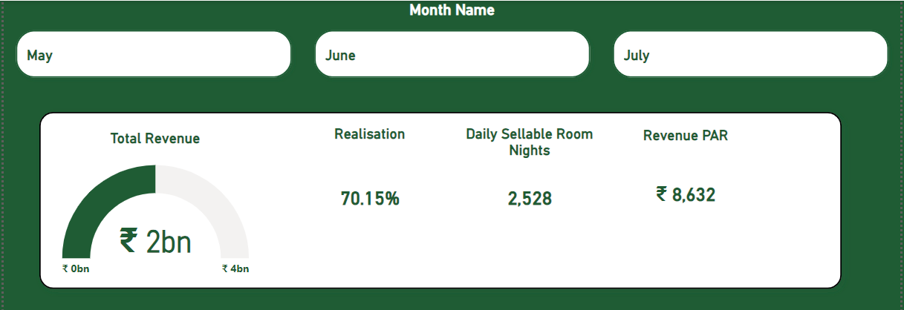


Dashboard Overview
This dashboard highlights key performance metrics such as revenue, realisation, daily sellable room nights (DSRN), and revenue per available room (RevPAR).
Data analyzed from May to July 2024, across various cities and room types.

Slide 3

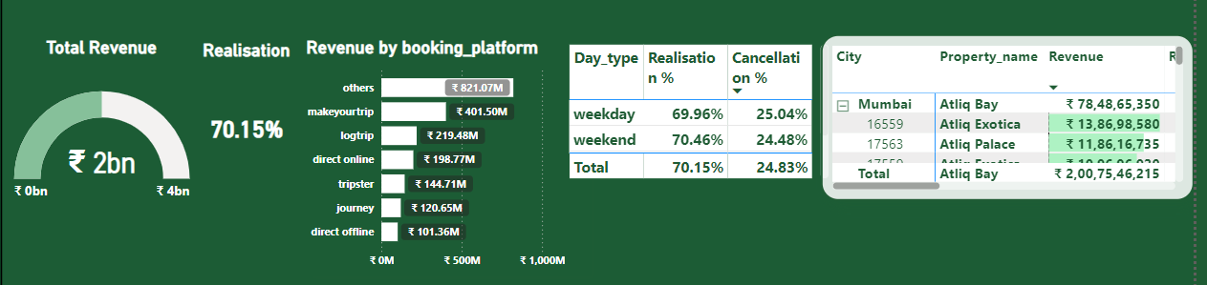
Key Metrics and Insights
- Total Revenue: 2bn, with 70.15% realization.
- Highest revenue by booking platform: Others (821.07M).
- Weekends show higher realization (70.46%) compared to weekdays (69.96%).
- Mumbai properties perform the best, especially Atiq Bay and Atiq Exotica.
1
2
3
4

Slide 4
Suggestions for Business Growth
1. Optimize Weekend and Seasonal Pricing: Implement dynamic pricing strategies during high-demand periods (e.g., weekends, holidays) to maximize realization. Introduce attractive packages or discounts during low-demand periods to sustain occupancy.
2. Leverage High-Performing Platforms: Focus on top revenue-generating platforms like Makeyourtrip and Others. Improve visibility and engagement on underutilized channels such as Journey and Direct Offers to drive incremental bookings.
3. Enhance Guest Experience and Ratings: Target properties with ratings below 3.5 stars for operational improvements. Invest in guest satisfaction initiatives such as personalized services and faster issue resolution to boost occupancy and ADR.
4. Expand Operations in High-Performing Regions:
Explore growth opportunities in cities such as Mumbai, which demonstrate strong demand and revenue potential.
5. Reduce Cancellations and Maximize Realization Rates: Analyze cancellation trends and introduce flexible policies or incentives to encourage non-cancellable bookings.
6. Promote Direct Bookings: Introduce loyalty programs and exclusive offers to shift customers towards direct booking channels, reducing dependency on third-party platforms and improving margins.

Slide 5
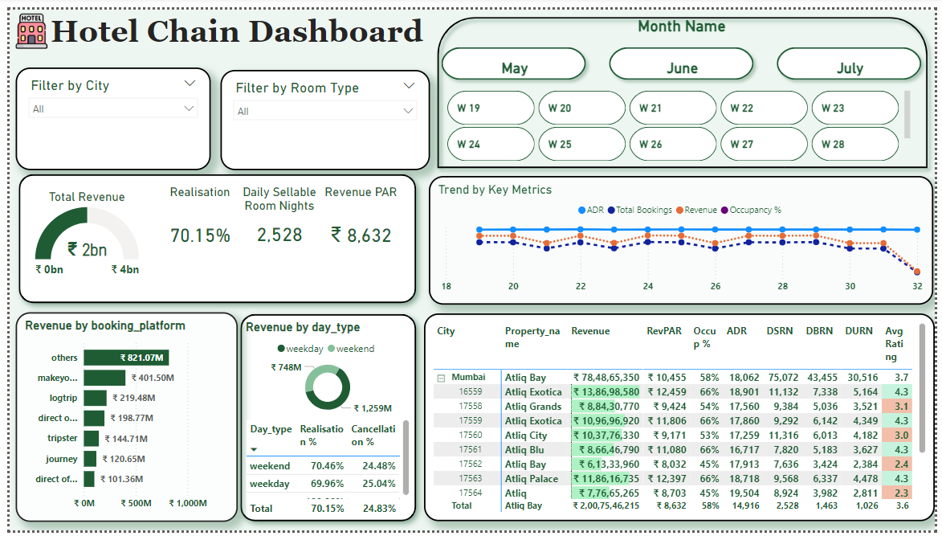




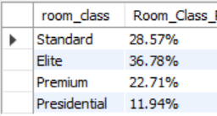


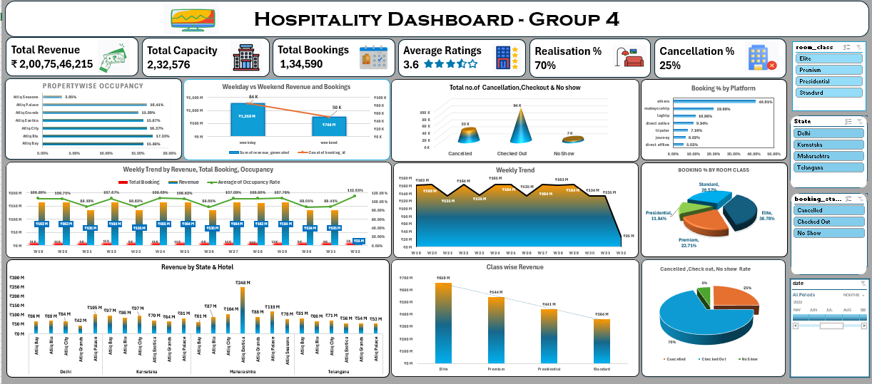
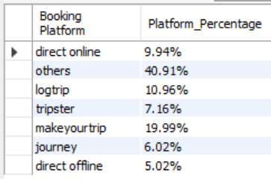



Team Acknowledgment
This Project was executed by a collaborative effort from our team members:
- Sonam Bhanarkar
- Vaishnavi Yogesh Ambre
- Pranav Arun Ghadi
- Kaipakam Vasu
- Thakur Rachita Varma
Using tools like Excel, Tableau, Power BI, and My SQL.

Slide 6

Summary and Next Steps
Key Insights Recap:
• Explored key insights from the hospitality dashboard.
• Highlighted critical performance metrics such as revenue, realization rate, and occupancy.
• Identified actionable recommendations for driving business growth.
Data-Driven Approach:
• Utilized a data-driven methodology to pinpoint areas of focus.
• Uncovered opportunities for improvement and business expansion.
Call to Action:
• By implementing these recommendations, the company can enhance profitability and customer satisfaction.
• Next steps: Prioritize actionable items such as optimizing pricing, addressing cancellations, and leveraging high-performing platforms.
"Taking off to growth with data-driven insights"

Slide 7


Thank you

